Slide 1


2019 TECH(K)NOW Day Taipei
Let’s
For Web!
Benjamin Wang @ Golang Taiwan
2019.4.20
Notes:
https://github.com/golang-samples/gopher-vector

Slide 2

User Login

Slide 3
r.GET("/login", loginPage)
func loginPage(c *gin.Context) {
c.HTML(http.StatusOK, "login.html.tmpl", gin.H{})
}

Slide 4
<form action="login" method="POST">
<div>
<label for="username"><b>Username</b></label>
<input type="text" name="username" id="username" required>
<br>
<label for="password"><b>Password</b></label>
<input type="password" name="password" id="password" required>
<br>
<button type="submit">Login</button>
</div>
</form>

Slide 5
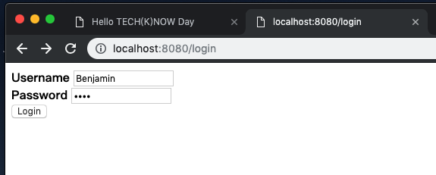

Slide 6
func login(c *gin.Context) {
username := c.PostForm("username")
password := c.PostForm("password")
log.Println("username:", username)
if username == "Benjamin" && password == "1234" {
c.String(http.StatusOK, "Hi "+username)
} else {
c.String(http.StatusOK, fmt.Sprintf("%s password error", username))
}
}

Slide 7

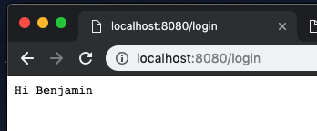
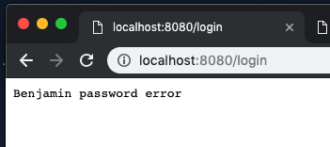

Slide 8
Header HTML Template

Slide 9
header.html.tmpl
<!--header.html.tmpl-->
<html>
<head>
<title>Hello TECH(K)NOW Day</title>
</head>
<body>
<h1>{{.Title}}</h1>
<img src="/assets/images/gopher.png" width="100">

Slide 10
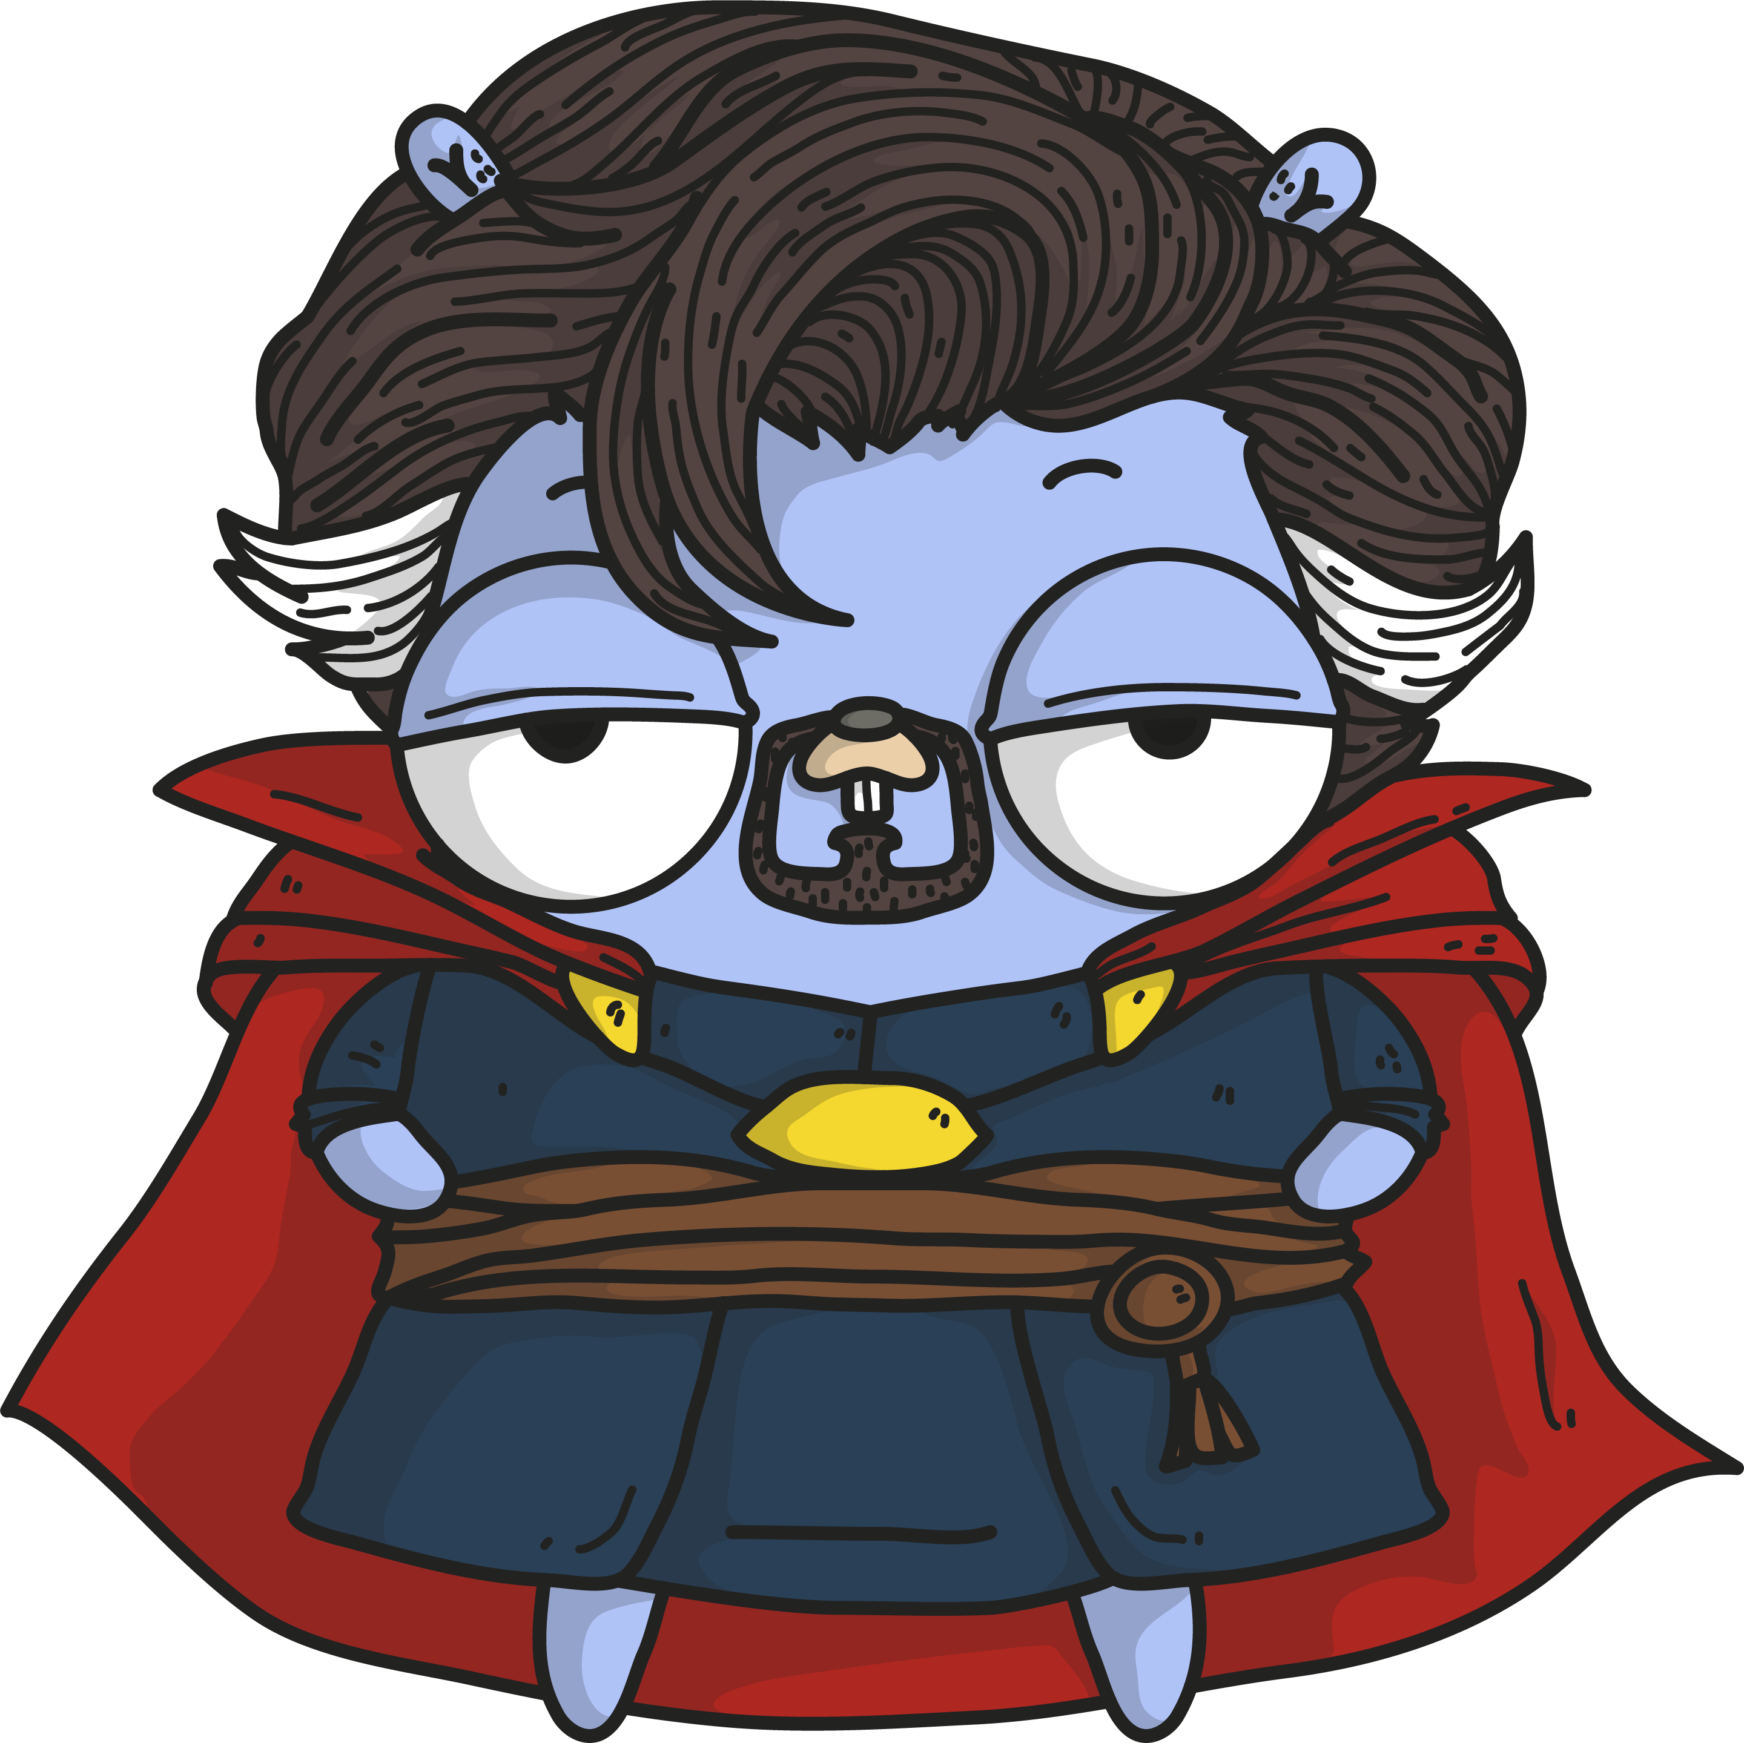
login.html.tmpl
{{ template "header.html.tmpl" .}}
<form action="login" method="POST">
<div>

Slide 11
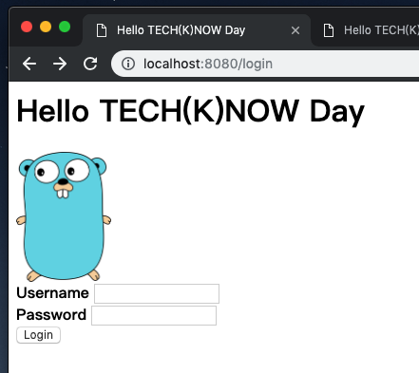

Slide 12

Cookie
http://pngimg.com/imgs/food/cookie/

Slide 13
func (c *Context) SetCookie(name, value string, maxAge int, path, domain string, secure, httpOnly bool)
name: cookie key
value: cookie value
maxAge: live time
path: available path
domain: available domain
secure: only https?
httpOnly: only http and https?

Slide 14
if username == "Benjamin" && password == "1234" {
c.SetCookie("username", username, 60, "/", "localhost", false, true)
c.String(http.StatusOK, "Hi "+username)

Slide 15
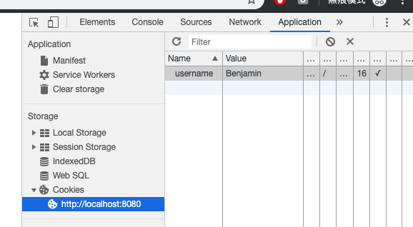

Slide 16
Socket

Slide 17
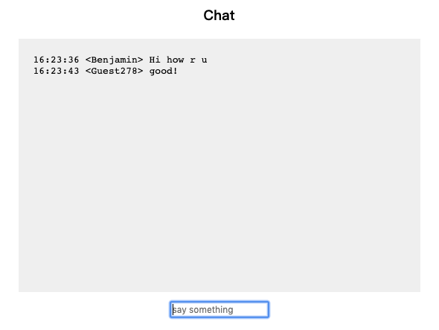

Slide 18
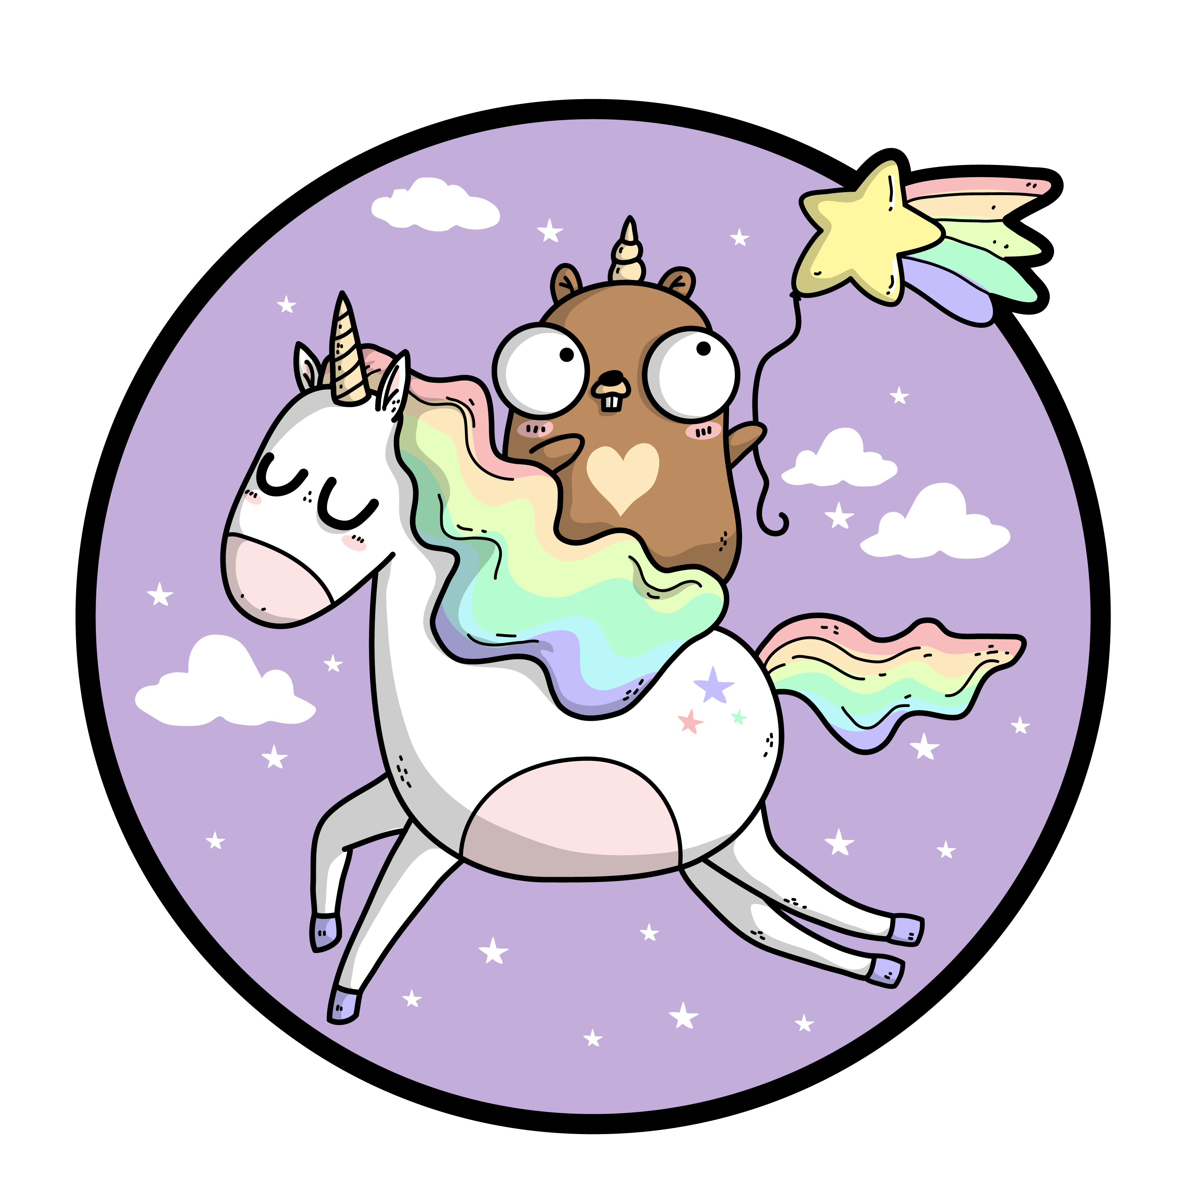
$ go get -u gopkg.in/olahol/melody.v1

Slide 19
import (
"fmt"
"log"
"net/http"
"github.com/gin-gonic/gin"
melody "gopkg.in/olahol/melody.v1"
)

Slide 20
r := gin.Default()
m := melody.New()
r.GET("/chat", chat)
r.GET("/ws", func(c *gin.Context) {
m.HandleRequest(c.Writer, c.Request)
})
m.HandleMessage(func(s *melody.Session, msg []byte) {
m.Broadcast(msg)
})

Slide 21
func chat(c *gin.Context) {
username, _ := c.Cookie("username")
c.HTML(http.StatusOK, "chat.html.tmpl", gin.H{
"username": username,
})
}

Slide 22


Slide 23
Q & A

